Slide 1

Edge Computing
Supply Chain Optimization in
Whirlpool’s logistics management

Slide 2

Edge Computing in Whirlpool’s logistics management Challenge (Supply Chain Optimization)
Whirlpool having issue with their centralized management system to track device health, productivity, location, and ensure proper deployment.
Whirlpool wanted to optimize mobile device management at its distribution centers. Leadership ran into problems with misplaced devices, battery life, the inability to update devices in a systematic way, and a lack of data metrics around device performance.
If the spreadsheet wasn’t maintained, devices could be lost, and this led to more equipment purchases and overall inefficiency across nearly all the 20 distribution centers. If a battery died during an associate’s task, it hurt that associate’s productivity because the size of the distribution centers made it difficult for the associate to quickly reach a central location where charged batteries were available.
Major Challenges:
Device Misplacement:
Workers usually misplace the device and tracking them would be hard to track every day.
Service Updates:
Identifying the Bugs and new features was not been tracked which resulted in the loss of data recording.
Performance Tracking:
Worker/Device efficiency and the activity can be tracked based on the usage & to be monitored for quick turnaround.
Battery Misplacement:
Dead batteries could bring down the performance of the worker/device.

Slide 3
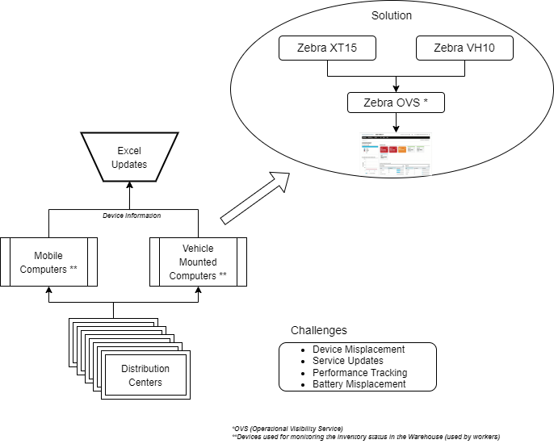
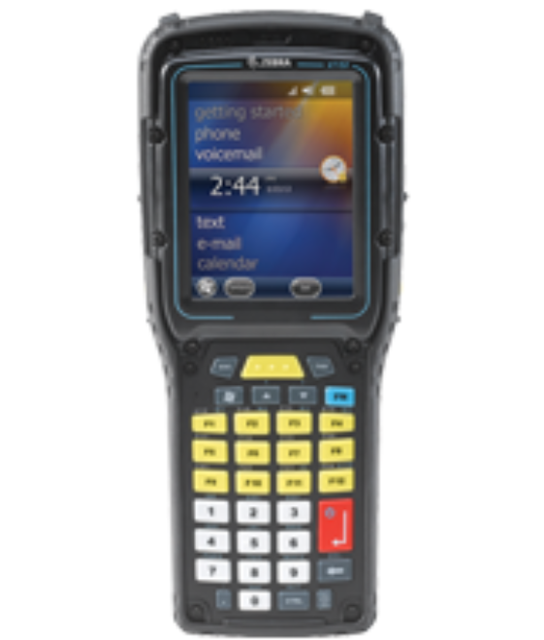
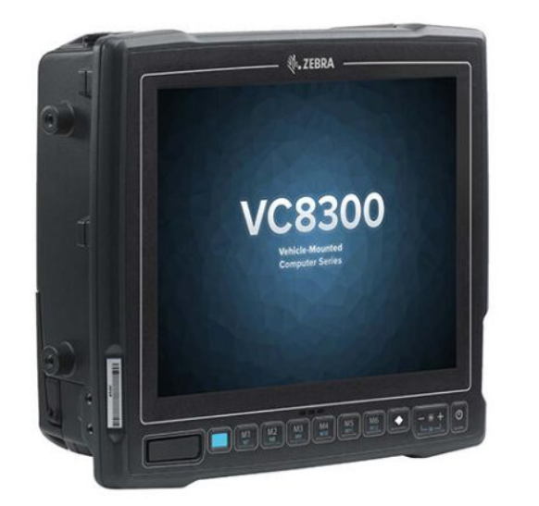
Edge Computing in Whirlpool’s logistics management Architecture
Excel/Spreadsheet Tracking
ZERBA VH10
Installed on motorized pallet truck
ZEBRA XT15
Hand held RFID Scanner for workers
Edge Solution
Edge Technologies include :
Zebra XT15 mobile computers - Device
VH-10 vehicle-mounted computers - Device
Zebra’s Operational Visibility Service (OVS). – Software Service

Slide 4
Edge Computing in Whirlpool’s logistics management Solution
Whirlpool has worked with Industrial Service Technology (IST), a Zebra partner, for almost 20 years and the relationship has grown to IST providing Whirlpool with hardware and software solutions for warehouse management, RF, and RFID systems. IST centers its warehouse management systems around Zebra hardware.
Whirlpool utilizes Zebra
XT15 mobile computers,
VH10 vehicle-mounted computers,
Zebra’s Operational Visibility Service (OVS).
The VH10 and XT15 are extremely rugged, reliable devices that suit the distribution center well. OVS helps Whirlpool and IST right-size equipment, understand needs of the pool, and understand site-by-site needs. This combination allows Whirlpool and IST to sense when there could be a problem, analyze what it is, and act on a solution in real-time. That’s something they simply couldn’t do when the process was managed through spreadsheets.
Results:
Remote rollouts on the device from the central location was successful and efficient over 18 locations.
After the implementation during November and early January (within 3 Months), they recovered 63% ROI on the deployment.
If the Distribution Centers needs VH10’s or more XT15’s, OVS gives managers the visibility they need to make better, smarter decisions with device mix.

Slide 5
Edge Computing in Whirlpool’s logistics management – Reference
Industrial Service Tech - https://www.industrialservicetech.com/wp/
Abi Research Blogs - https://www.abiresearch.com/blogs/2022/05/10/the-case-for-edge-computing-to-improve-supply-chain-optimization/
Zebra Company Website - https://www.zebra.com/us/en/products.html
Whirlpool Company Website - https://www.whirlpoolindia.com/
Review from the Company Management:
“We can track actual utilization by device, that can be mapped back to an associate so we can understand the productivity of that particular associate.”
- A. Scott Baiers, Former Manager of Supply Chain Logistics Whirlpool Corporation –
“With the combination of Whirlpool Corporation working with Zebra and IST, the technology future is unlimited.”
- Alison Jones, Former Senior Director of North America Logistics Whirlpool Corporation -
https://www.zebra.com/us/en/services/visibilityiq/foresight.html?tactic_type=WBP&tactic_detail=Desc_AV_GL_None_Youtube?tactic_type=WBP&tactic_detail=Desc_AV_GL_None_Youtube

Slide 6
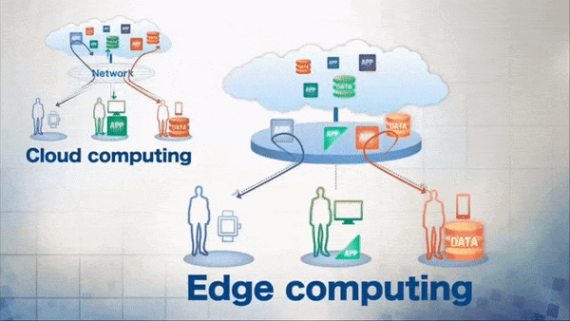
Edge Computing Example (process example)

